Slide 1


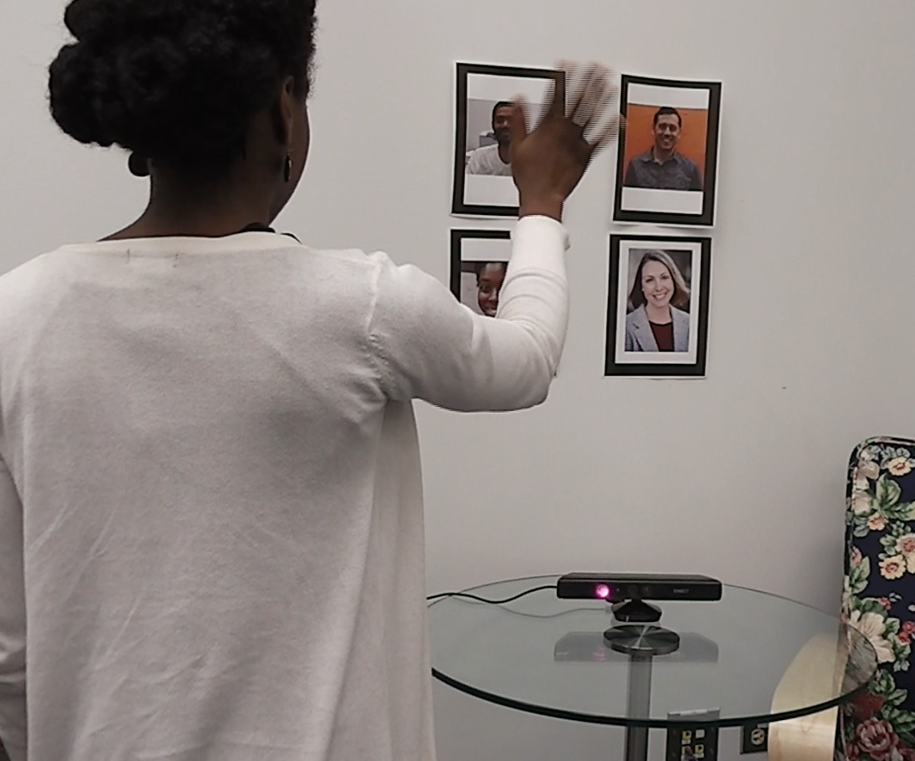
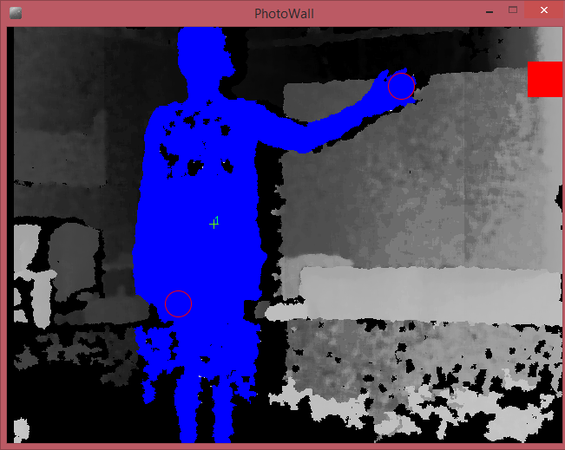
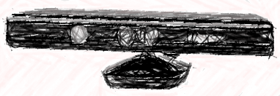


@
PORTRAIT PIGEON
An Interactive Photo Messaging Wall for Seniors
Robin Brewer | Moritz Gellner | Anne Marie Piper
rnbrewer@u.northwestern.edu
Variety of disabilities makes ACCESSING COMPUTERS DIFFICULT for some seniors
Prior research highlights their values of KEEPING IN TOUCH and storing non-digital PHOTOS
PORTRAIT PIGEON! A messaging platform embedding online communication into non-digital photos
+
+
=
SimpleOpenNI
lightweight communication platform
Due to its popularity with seniors, supports E-MAIL messages
Supports posts to SOCIAL MEDIA (e.g. Twitter, Facebook)
Extensible to VOICE input and RECIPROCAL communication
flexible gesture framework
RELATIVE TARGET RECOGNITION, based on user’s torso
Wide RANGE of physical and cognitive disabilities
Positioning can be CUSTOMIZED to best fit ability of the user
feedback mechanisms
AUDIO feedback or hearing-impaired
Extensible to multimodal VISUAL FEEDBACK to signal message sent
Visual FEEDBACK TO GUIDE USER to better positioning
Future Applications
community bulletin boards staff photo walls
art exhibits
resident mailboxes
Current Application
private photo walls

